Slide 1
MRUH
Evaluation of Machine Learning Algorithms for the Detection of Fake Bank Currency
Application Development 2 : Machine Learning
PROJECT TEAM MEMBERS:
2011CS020006 AJAY KUMAR
2011CS020007 AKASH
2011CS020008 ANEESH
2011CS020009 HARI GAUTHAM
2011CS020010 JATIN
GUIDED BY
Prof. Veena Rani

Slide 2
ABSTRACT:
PROBLEM DEFINITION : After Demonetization , Fake Currency has increased more in the society. This will reduce the country economy and decrease the poverty. To avoid this someone has to monitor the currency whether it is real or forged. It is very difficult for a human to check every currency. So here is an approach to decrease the man power and with the help of these algorithms we can find whether the given currency is fake or real.
OBJECTIVE OF THE PROJECT : The main moto of this project is to find whether the currency is forged or real. For that we have taken datasets such as 500/- , 2000/- currency datasets and train the model.
LIMITATIONS OF THE PROJECT : There are some limitations in this project. Those are Quality of the currency, Scanning the currency, Making certain points as constants in the currency such as emblem, recognizing strips of the currency , etc..,

Slide 3
ANALYSIS OF THE PROJECT :
INTRODUCTION : Create discrepancies of money miscreants introduce the fake notes which resembles to original note in the financial market. During demonetization time it is seen that so much of fake currency is floating in market. In general by a human being it is very difficult to identify forged note from the genuine . To discriminate between fake bank currency and original note is a challenging task. So, there must be an automated system that will be available in banks or in ATM machines. To design such an automated system there is need to design an efficient algorithm which is able to predict weather the banknote is genuine or forged bank currency as fake notes are designed with high precision. particular train test ratio.
ALGORITHMS :
Support Vector Machine (SVM)
Random Forest
Decision Tree
K-Nearest Neighbour
Naïve Bayes

Slide 4
REQUIREMENT :
SOFTWARE REQUIREMENT : During this project, we have used some software tools to perform the tasks of the modules.
Jupyter Notebook
PyCharm
Spyder
HARDWARE REQUIREMENT : We performed this project based on some hardware requirements to better performance of the project.
RAM : 4 GB
ROM : 20 GB
PROCESSOR : i5
ARCHITECTURE : 4 Core

Slide 5
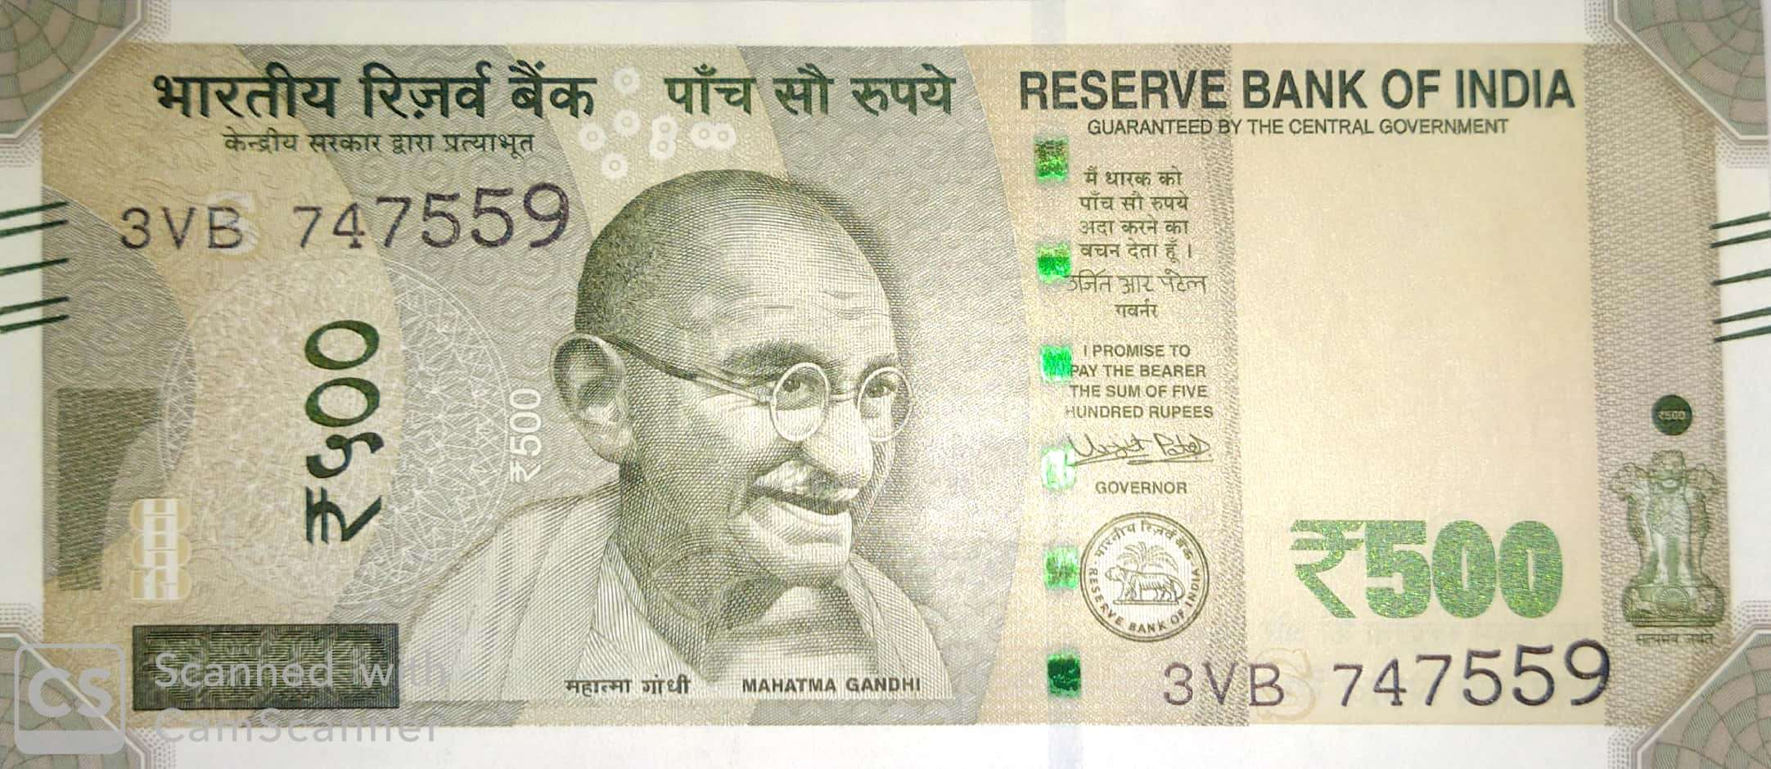
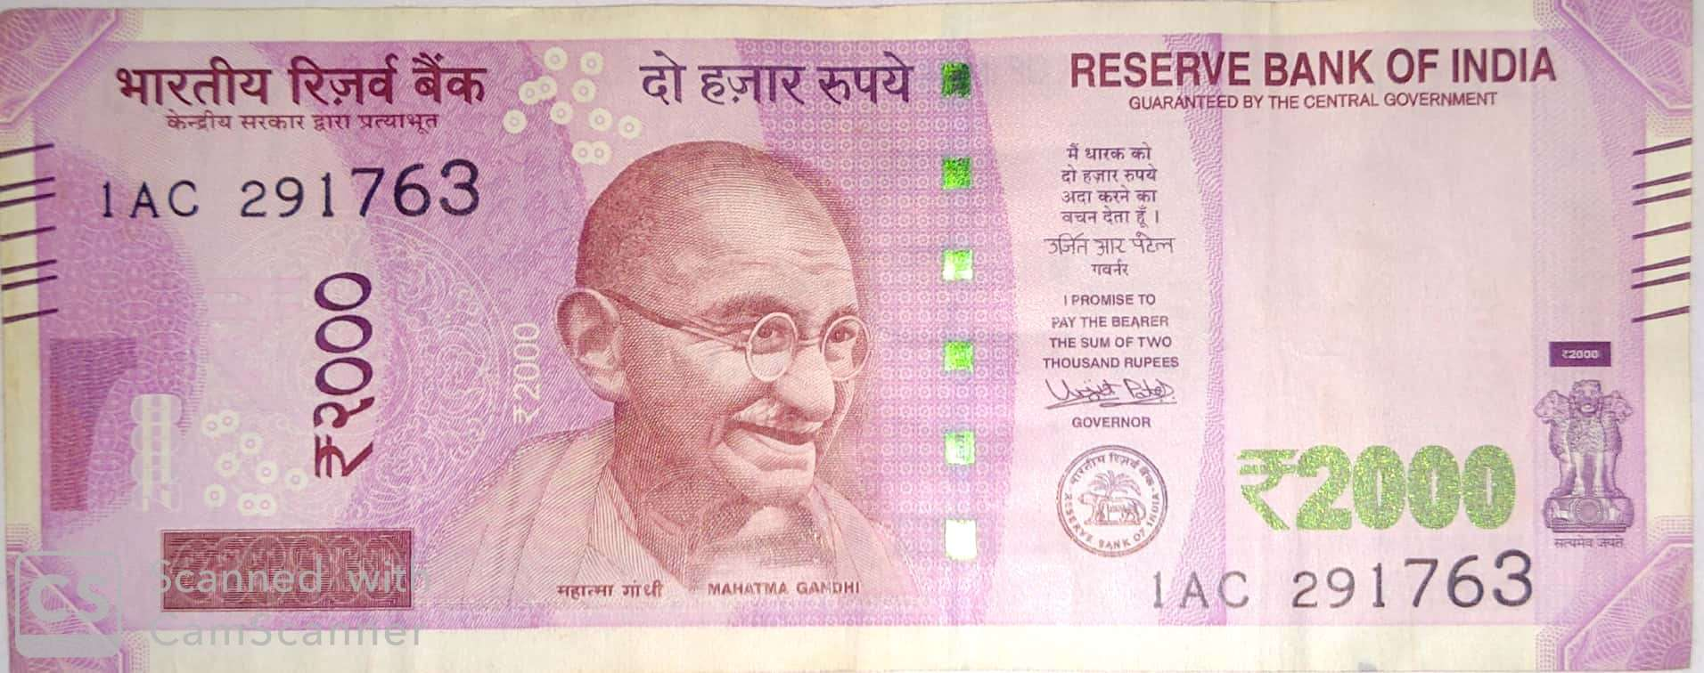
ANALYSIS OF CURRENCY :
We had taken some parameters to analyze the currency such as….
Towards the right side, you will find the signature of RBI Governor Urjit Patel with promise clause and the RBI emblem.
To the left hand side of the Mahatma Gandhi portrait, you will see the number 2000 printed in Devnagari script.
The security thread woven into the note is a multicolor one that carries the words ‘RBI’ and ‘Bharat’ in Devanagari and the numeral ‘2000’ when viewed from different angles.
Based on these parameters we will be predicting the currency notes.
500 /- Rupee Note
2000 /- Rupee Note

Slide 6
EXISTING SYSTEM :
In existing system, Image processing Is being used with legacy version of machine learning algorithm. Also, they are using local database which reduces the portability of system and because of their system is limited to PC device user friendliness is not good.
PROPOSED SYSTEM :
In proposed work, we will develop a system that would perfectly assess the features of fake note and real notes based on the paper by Prof. Anju Yadav, Prof. Tarun Jain, Prof. Vivek Kumar Varma, Prof. Vipin Paul. Our proposed system will be capable of performing real time detection of fake currency as we are using SVM, Logistic Regression, Random Forest.

Slide 7
CONCLUSION AND FUTURE SCOPE :
Our System will be helpful for the regular peoples who are technically not involved in daily life with background processes. A smartphone app will provide its user an concise way to perform a very necessary task.
In forthcoming future, we will be able to embed this application in smart phones using OCR(Optical Character Recognition) hence there is no need for a user to go somewhere to verify whether the currency is real or forged.
In upcoming future, we will be able to apply the methodologies for foreign currencies such as dollars ,yens , etc..,
You can find the project on
Github.com/JatinAllamsetty27

